Slide 1
Property TV Management System
Submitted by: Mary Rose Pasco
Submitted to: Prof. Jonathan Fuller

Slide 2
Project Description
The Property TV Management System is designed to manage hotel properties, TV equipment, and technical support tickets. It allows administrators to maintain property records, monitor equipment such as SmartBoxes, splitters, and satellite dishes, and track reported technical issues.
The system centralizes property, equipment, and ticket information in a single database, making it easier to monitor equipment status, manage support requests, and efficiently track issues from creation to resolution.

Slide 3
Reason for Selecting the Project
I selected this project because it is closely related to my current work environment. I regularly handle property support tickets, SmartBox devices, satellite equipment, and technical troubleshooting activities. Developing this system allows me to apply database concepts to a real-world scenario that I am familiar with while creating a practical solution for managing property TV services.

Slide 4
System Features
Feature 1: Property Management
Description:
This feature allows users to manage property information stored in the system. Users can add, update, and view property records such as property name, location, and contact number.
Functions:
Add Property
Update Property Information
View Property Details

Slide 5
Feature 2: Equipment Management
Description:
This feature is used to manage and monitor television distribution equipment assigned to each property. Equipment information such as equipment type, serial number, and operational status can be recorded and viewed.
Functions:
Add Equipment
View Equipment Information
Monitor Equipment Status

Slide 6
Feature 3: Ticket Management
Description:
This feature allows users to record and track technical issues reported by properties. It helps monitor ticket status from creation until resolution.
Functions:
Create Ticket
Update Ticket Status
View Ticket Records

Slide 7
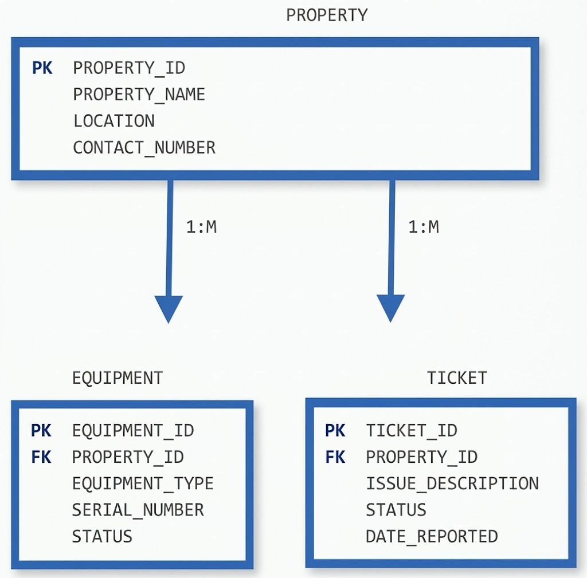
ER Diagram
Relationship Description
One Property can have many Equipment records.
One Property can have many Ticket records.
Each Equipment belongs to one Property.
Each Ticket belongs to one Property.

Slide 8
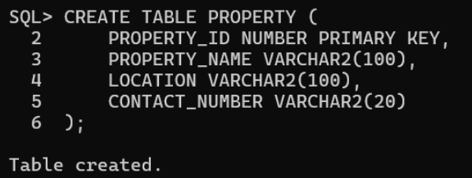
Database Schema Implementation
A. CREATE TABLE Statements
PROPERTY Table
The PROPERTY table stores property information including the property name, location, and contact number.
CREATE TABLE PROPERTY (
PROPERTY_ID NUMBER PRIMARY KEY,
PROPERTY_NAME VARCHAR2(100),
LOCATION VARCHAR2(100),
CONTACT_NUMBER VARCHAR2(20)
);

Slide 9
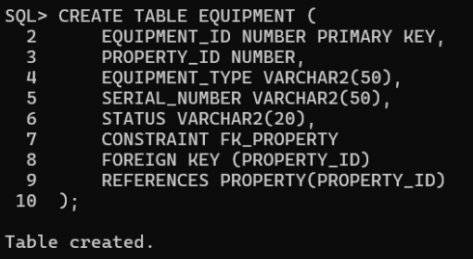
CREATE TABLE Statements
EQUIPMENT Table
The EQUIPMENT table stores information about the TV distribution equipment assigned to each property.
CREATE TABLE EQUIPMENT (
EQUIPMENT_ID NUMBER PRIMARY KEY,
PROPERTY_ID NUMBER,
EQUIPMENT_TYPE VARCHAR2(50),
SERIAL_NUMBER VARCHAR2(50),
STATUS VARCHAR2(20),
CONSTRAINT FK_PROPERTY
FOREIGN KEY (PROPERTY_ID)
REFERENCES PROPERTY(PROPERTY_ID)
);

Slide 10
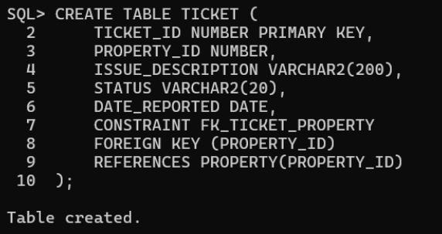
CREATE TABLE Statements
TICKET Table
The TICKET table stores technical issues reported by different properties.
CREATE TABLE TICKET (
TICKET_ID NUMBER PRIMARY KEY,
PROPERTY_ID NUMBER,
ISSUE_DESCRIPTION VARCHAR2(200),
STATUS VARCHAR2(20),
DATE_REPORTED DATE,
CONSTRAINT FK_TICKET_PROPERTY
FOREIGN KEY (PROPERTY_ID)
REFERENCES PROPERTY(PROPERTY_ID)
);

Slide 11
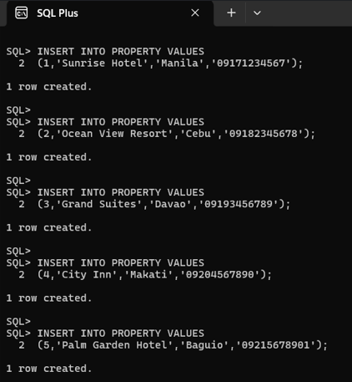
B. INSERT Statements
PROPERTY Table Records
The following SQL statements were used to insert sample property records
into the PROPERTY table.
INSERT INTO PROPERTY VALUES
(1,'Sunrise Hotel','Manila','09171234567');
INSERT INTO PROPERTY VALUES
(2,'Ocean View Resort','Cebu','09182345678');
INSERT INTO PROPERTY VALUES
(3,'Grand Suites','Davao','09193456789');
INSERT INTO PROPERTY VALUES
(4,'City Inn','Makati','09204567890');
INSERT INTO PROPERTY VALUES
(5,'Palm Garden Hotel','Baguio','09215678901');

Slide 12
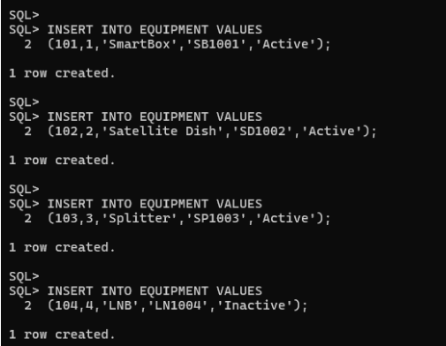
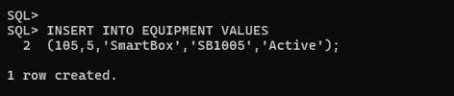
INSERT Statements
EQUIPMENT Table Records
The following SQL statements were used to insert equipment information
into the EQUIPMENT table.
INSERT INTO EQUIPMENT VALUES
(101,1,'SmartBox','SB1001','Active');
INSERT INTO EQUIPMENT VALUES
(102,2,'Satellite Dish','SD1002','Active');
INSERT INTO EQUIPMENT VALUES
(103,3,'Splitter','SP1003','Active');
INSERT INTO EQUIPMENT VALUES
(104,4,'LNB','LN1004','Inactive');
INSERT INTO EQUIPMENT VALUES
(105,5,'SmartBox','SB1005','Active');

Slide 13
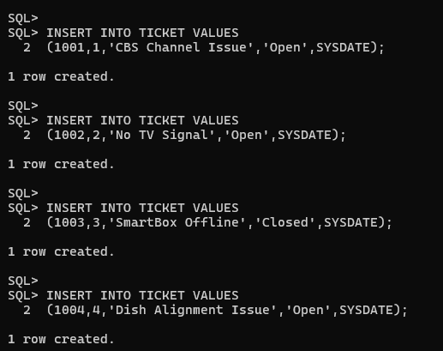

INSERT Statements
TICKET Table Records
The following SQL statements were used to insert ticket records
into the TICKET table.
INSERT INTO TICKET VALUES
(1001,1,'CBS Channel Issue','Open',SYSDATE);
INSERT INTO TICKET VALUES
(1002,2,'No TV Signal','Open',SYSDATE);
INSERT INTO TICKET VALUES
(1003,3,'SmartBox Offline','Closed',SYSDATE);
INSERT INTO TICKET VALUES
(1004,4,'Dish Alignment Issue','Open',SYSDATE);
INSERT INTO TICKET VALUES
(1005,5,'Splitter Replacement Needed','Closed',SYSDATE);

Slide 14
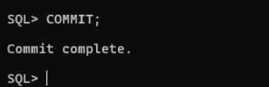
COMMIT Statement
The COMMIT statement was executed to permanently save all inserted records into the database.
COMMIT;

Slide 15
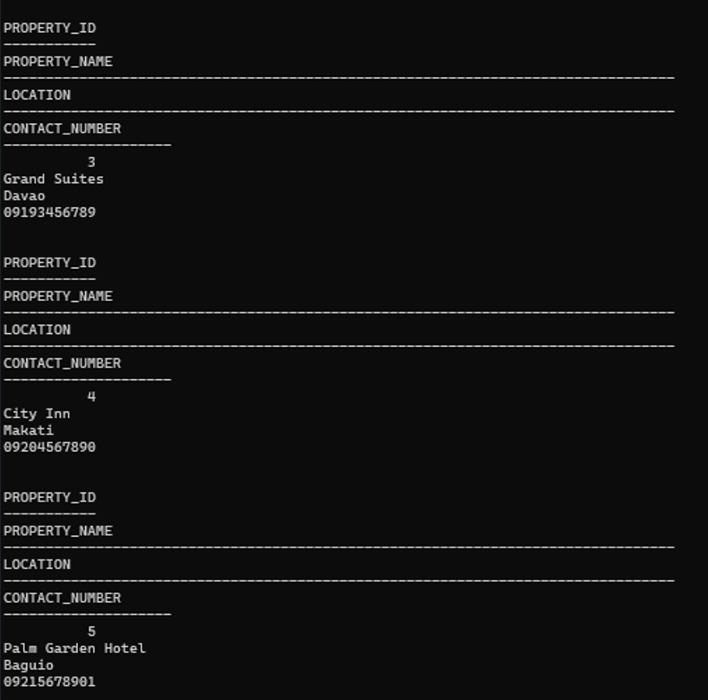
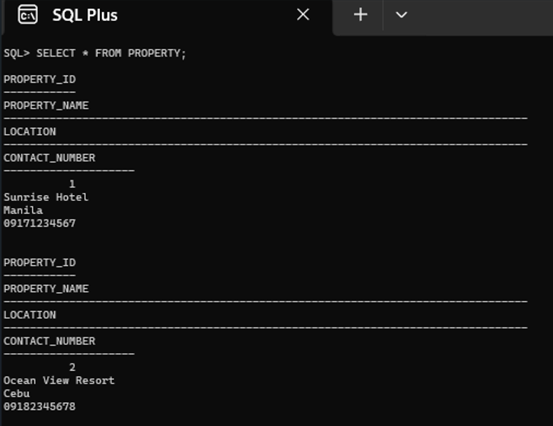
C. SELECT Statements
Simple Select Statement
SELECT * FROM PROPERTY;
The following query displays all records from the PROPERTY table.

Slide 16
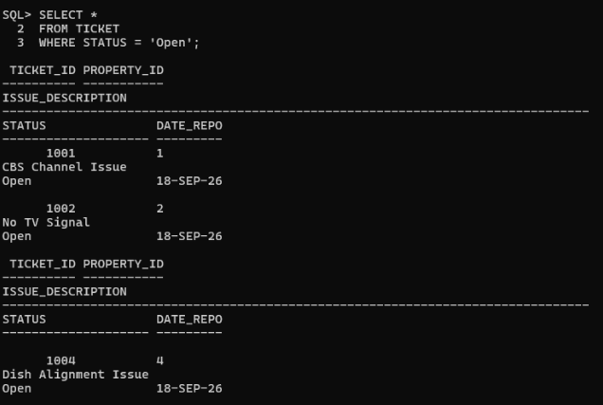
SELECT Statements
WHERE Condition
SELECT *
FROM TICKET
WHERE STATUS = 'Open';
The following query displays all tickets with
an Open status.

Slide 17
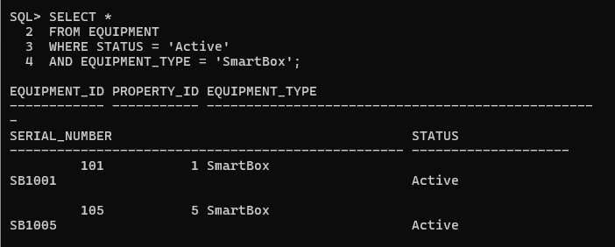
SELECT Statements
Logical Condition
SELECT *
FROM EQUIPMENT
WHERE STATUS = 'Active'
AND EQUIPMENT_TYPE = 'SmartBox';
The following query displays active SmartBox
equipment.

Slide 18
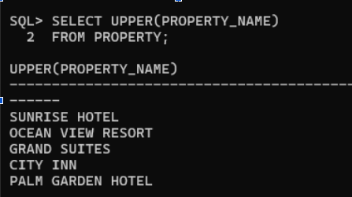
SELECT Statements
Single Row Function
SELECT UPPER(PROPERTY_NAME)
FROM PROPERTY;
The following query converts all property names into uppercase
letters using the UPPER() function.

Slide 19
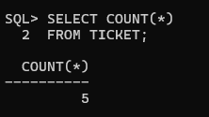
SELECT Statements
Multiple Row Function
SELECT COUNT(*)
FROM TICKET;
The following query counts the total number of records
in the TICKET table.

Slide 20
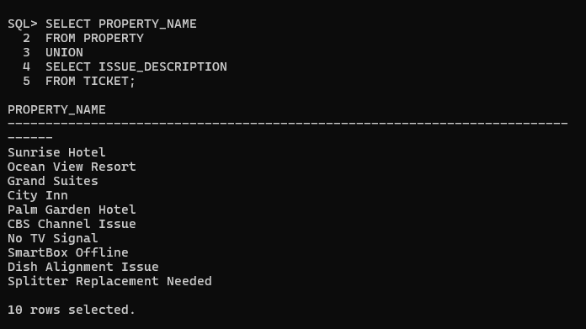
SELECT Statements
UNION Set Operator
SELECT PROPERTY_NAME
FROM PROPERTY
UNION
SELECT ISSUE_DESCRIPTION
FROM TICKET;
The following query combines records from the
PROPERTY and TICKET tables while removing
duplicate values.

Slide 21
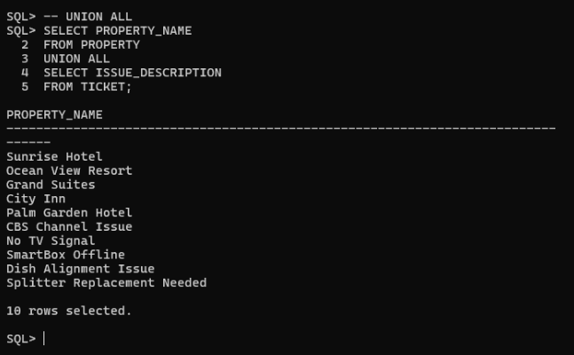
SET OPERATORS
UNION ALL
SELECT PROPERTY_NAME
FROM PROPERTY
UNION ALL
SELECT ISSUE_DESCRIPTION
FROM TICKET;
The following query combines the results of two queries
and includes all records, including duplicate values.

Slide 22
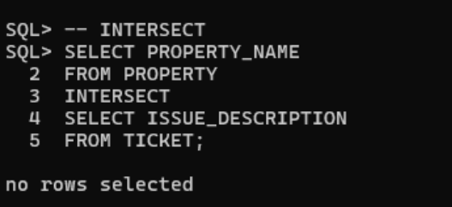
SET OPERATORS
INTERSECT
SELECT PROPERTY_NAME
FROM PROPERTY
INTERSECT
SELECT ISSUE_DESCRIPTION
FROM TICKET;
The following query returns records that are common between two queries.

Slide 23
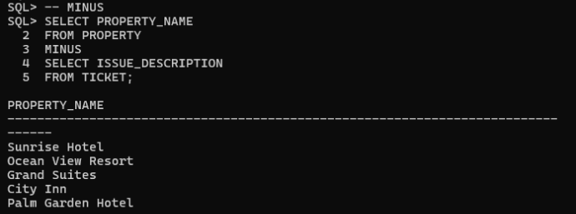
SET OPERATORS
MINUS
SELECT PROPERTY_NAME
FROM PROPERTY
MINUS
SELECT ISSUE_DESCRIPTION
FROM TICKET;
The following query returns records from the first query that are not present in the second query.

Slide 24
Reflection
Set Operators: UNION, UNION ALL, INTERSECT, and MINUS
Set operators are useful SQL commands that allow users to combine and compare the results of different queries. They help organize and analyze data more efficiently, especially when working with multiple tables.
UNION and UNION ALL are both used to combine the results of two queries. The difference is that UNION automatically removes duplicate records, while UNION ALL keeps all records, including duplicates. Because UNION checks for duplicate values, it may take more processing time. On the other hand, UNION ALL is usually faster because it simply combines all records without performing duplicate checks.
INTERSECT is used to display only the records that exist in both queries. It is helpful when finding common information between two tables. In this project, INTERSECT was used to compare data between the PROPERTY and TICKET tables and determine if there were matching records.
MINUS is used to display records that exist in the first query but not in the second query. This operator is useful when identifying unique records or checking differences between two sets of data. In the project, MINUS helped identify property records that did not appear in the ticket records.
Through this activity, I learned how set operators can be used to combine, compare, and filter data from different tables. These operators make SQL queries more powerful and help users generate meaningful results based on specific requirements.

Slide 25
CONCLUSION
The Property TV Management System was developed to manage property information, equipment records, and support tickets using a database system. Through this project, database concepts such as ER modeling, table creation, data insertion, data retrieval, functions, and set operators were applied. The project demonstrates how a database can be used to organize information efficiently and support operational activities.

Slide 26
THANK YOU!!

